Slide 1
Teaching Empathy
Dr Emma Brandon
2015

Slide 2
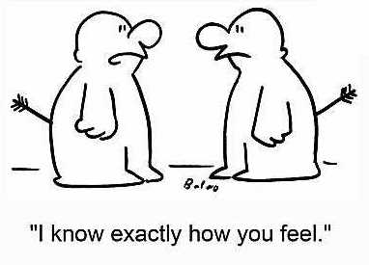

Slide 3
What is Empathy ?
A sense of self-awareness & ability to distinguish own feelings from others
Taking another person’s perspective
Being able to regulate one’s own emotions
Caring for people & wanting to help them
Discerning what another person is thinking/feeling
Ability to feel & share another person’s emotions
Altruistic
Other-aware

Slide 4
What is Empathy ?
Cognitive empathy- recognising the emotion
Emotional empathy- experiencing the emotion
Compassionate empathy- we want to help the other person deal with the situation & emotions
Difficult part is taking action that truly helps another
Neurological basis; Theory of Mind & Empathy
Emotional Intelligence

Slide 5
Emotional Intelligence
Ability to monitor one’s own & other’s emotions
To discriminate between emotions
To label them appropriately
To use emotional information to guide thinking & behaviour
Greater mental health, exemplary job performance, better leadership skills, increases empathy
Perceive emotions, understand emotions, use them & manage them
Notes:
Petr Salovey, John Mayer, Konstantin Vasily Petrides, Daniel Goleman

Slide 6
Why is Empathy important ?
Important survival skill
Sensing distress in a companion may help you recognise a threat
Develops early in children
Promotes pro-social behaviour, positive mental states and increases helping behaviours
Aids effective communication
Helps reduce burn-out
Increases effectiveness

Slide 7
Secular Ethics
Golden Rule
‘treat others as you want to be treated’
Platinum Rule
‘Treat others as they want to be treated’

Slide 8
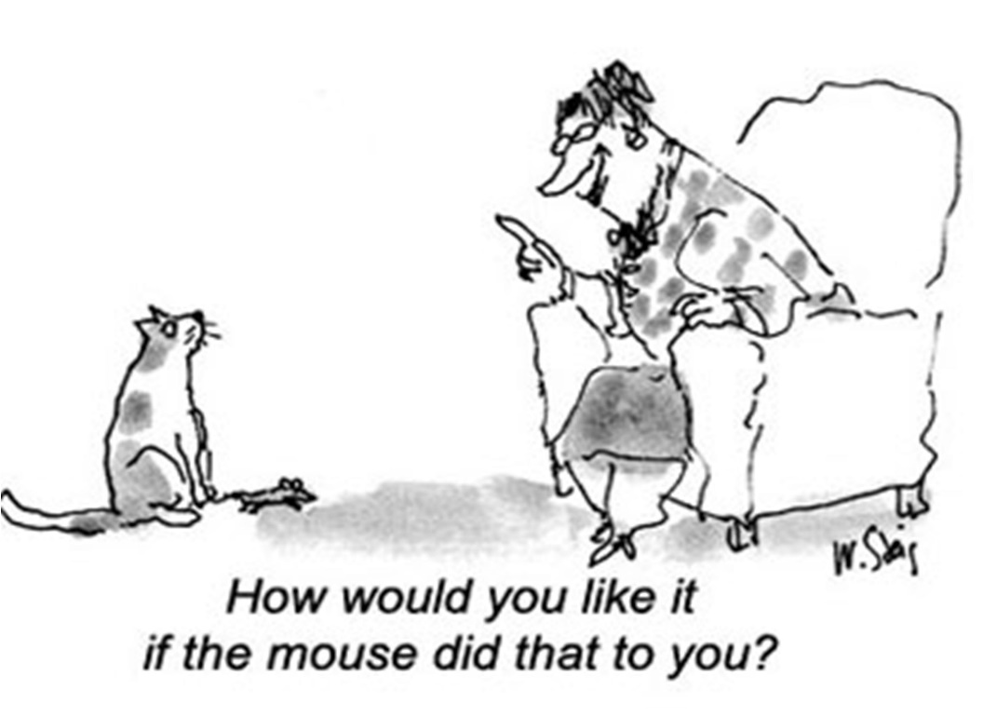

Slide 9
Promoting Empathy
With trainee:
Recognise a ‘struggling’ trainee
Tools to assess Empathy and Emotional Intelligence
Encourage Mind-mindedness, sympathy & self-awareness in feedback/CBD/assessments
Differences hinder empathy; recognise prejudices
Don’t have to ‘like’ someone
Recognise our ‘judgements’ of people
‘be interested’ in others
Notes:
Empathy quiz/Emotional Intelligence – Greater Good

Slide 10
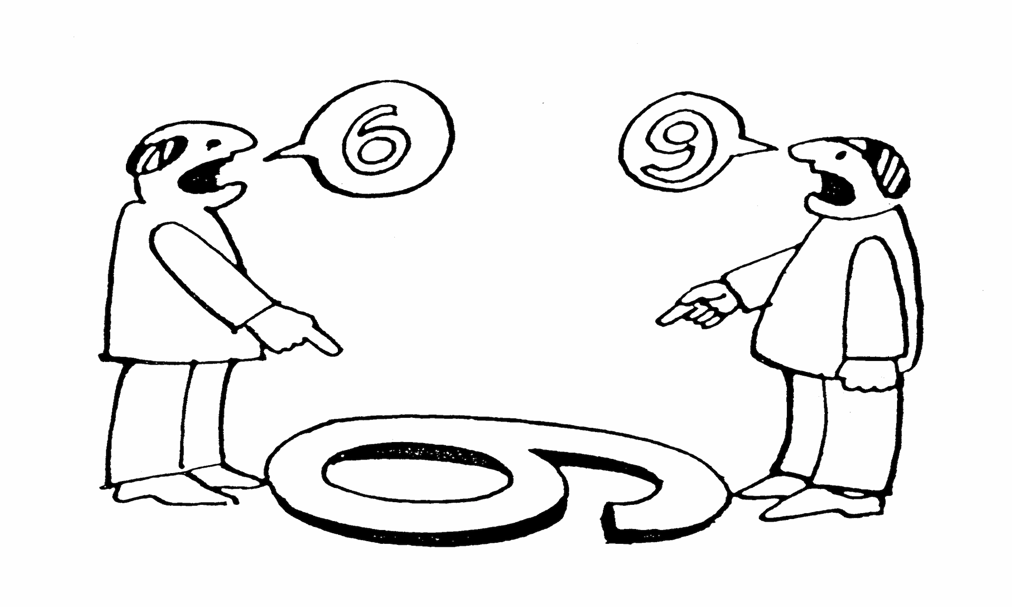
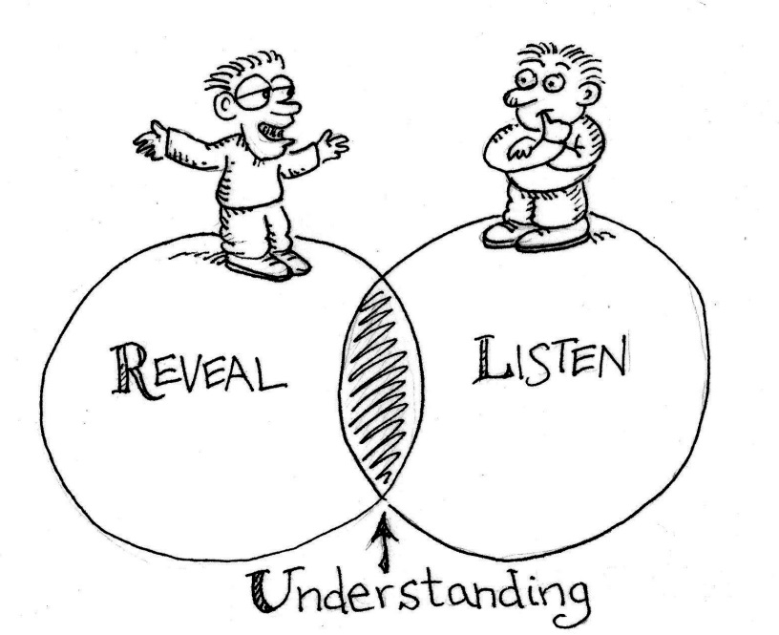
Promoting Empathy

Slide 11
Promoting Empathy
Trainees may avoid emotions in their patients
Use role play
Validate the other person’s perspective
Encourage them to put aside their point of view
Promote flexibility
View videos and critique listening skills
Listening with eyes, ears, instincts, heart
Practising empathic phrases
Focus on ICE
Help trainees access their emotions
Notes:
May be related to their own attachment, emotional intelligence,

Slide 12
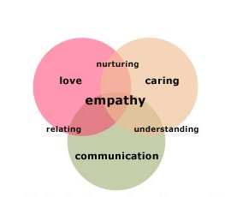
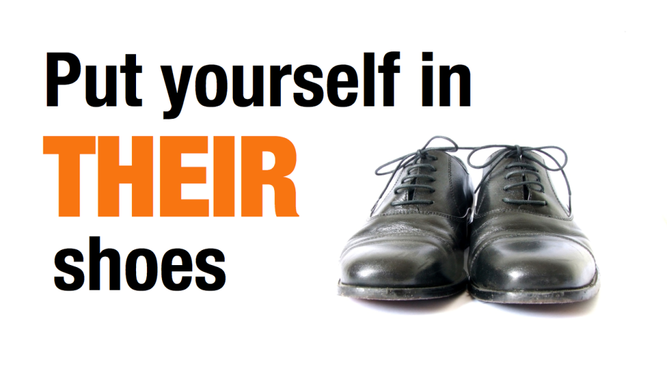
Promoting Empathy

Slide 13
Other Strategies
Practice active listening (in general life too)
Share in other people’s joy
Look for commonalities with others
Read fiction
Pay attention to faces
Cultivate curiosity in others/other cultures
Challenge prejudices/look for commonalities
Listen hard & open up
Ask other person to explain their position
Notes:
Understanding effects our subjective judgements.

Slide 14
Potential Problems
Confusing empathy with sympathy
Becoming over-involved
Blurring of professional boundaries
Not’ housekeeping’ the consultation
Emotional burnout
Longer consultations initially
Repeat attendance by patients/over-reliance on doctor
It is a complex skill !

Slide 15
Importance
Allows more advanced communication
More effective communication
Better outcomes for patients
Better mental health and reduced burnout for doctors
Reduced complaints
A broader life experience
Meets professional competencies

Slide 16
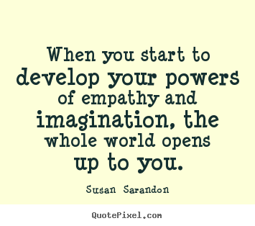
Food for thought

